Slide 1
Data Tools
(1) Introduction

Slide 2
Course
1 | Introduction to R
2 | Reproducible Research
3 | Data Organization
4 | Data Organization
5 | Data visualization
6 | Descriptive Models
7 | Advanced R

Slide 3

Textbook
Wickham, Hadley, and Garrett Grolemund. 2017. R for data science.
ISBN-10: 1491910399
ISBN-13: 978-1491910399

Slide 4
Resources
R for Data Science https://r4ds.had.co.nz
DataCamp https://datacamp.com
Cheatsheets https://rstudio.com/resources/cheatsheets
The tidyverse https://tidyverse.org
More books? Check the “Use R!” series from Springer. From (my) marketing perspective, this one is quite nice:
Chapman, Chris, and Elea McDonnell Feit. 2019. R for marketing research and analytics.
ISBN-10: 3030143155
ISBN-13: 978-3030143152

Slide 5
Teamwork
We will work in pairs … quite a bit
I will try to match more and less experienced participants

Slide 6
This class
1 | Goals
2 | Installation
3 | Tidyverse
4 | Getting started with RStudio
5 | Using ‘Base R’
6 | Objects
7 | Style
8 | Selecting Values
9 | Modifying Values
10 | Missing Data
11 | Data exploration

Slide 7
Goals

Slide 8
This class should help you to …
Perform data analysis
Import and manage structured and unstructured data
Manipulate, transform, and summarize your data
Understand different data sources and join if needed
Methodically explore and visualize your data
Understand functions and how they are written
Or simply: know the steps of the data journey and be able to execute them

Slide 9
The ‘data journey’
Visualize
Import
Tidy
Transform
Communicate
Model
Understand
This class (and the tidyverse functions) cover the entire data journey
Reproducible research tools allow performing all of these steps in one single process

Slide 10
Installation

Slide 11




Installing R and RStudio
R: https://cran.r-project.org/
RStudio: https://rstudio.com/products/rstudio/download/ (RStudio Desktop)
Linux: You probably know what you are doing
Sidenote: Try Intel’s Clear Linux (also runs on AMD) – it is fast
Windows: Install R and RStudio
Also, install Rtools (https://cran.r-project.org/bin/windows/Rtools/)

Slide 12

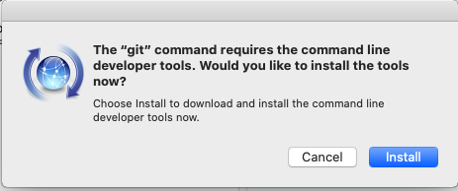
Installing R and RStudio
OSX: It’s a little bit more complicated …
You probably MUST install Xquartz: https://www.xquartz.org/
Two more things required for compiling (and installing packages from Github)
GCC/GFortran 8.2 (https://github.com/fxcoudert/gfortran-for-macOS/releases) and
CLI
type ‘xcode-select --install’ in a terminal window, or
on first launch of RStudio you may be prompted if you want to install CLI tools:
For more information: https://thecoatlessprofessor.com/programming/cpp/r-compiler-tools-for-rcpp-on-macos/

Slide 13





Editors / IDEs
There are alternatives to RStudio
Jupyter Notebooks (check anaconda documentation)
Visual Studio with R Tools for Visual Studio
PyCharm (developed for python, but also works well with R)
Tinn-R (once popular, but out-of-fashion now)
Notepad++ (great universal code editor)
While RStudio is not the fastest editor, its deep integration with several key R packages makes it a popular choice (and the choice for this class)

Slide 14
R versions
I recommend “Vanilla” R from CRAN, it works fine
Version 4.x is relatively new, and there were some changes that can affect backward-compatibility
Microsoft offers an ‘enhanced’ distribution of R on their version of CRAN called MRAN (https://mran.microsoft.com/open)
while it offers improved speed for some operations, it’s version number lags behind

Slide 15
Packages
install.packages(c("tidyverse","tidymodels", "lubridate", "tidytext", "modelr", "rvest", "httr", "pander","knitr","kableExtra", "summarytools","skimr","DescTools", "readxl","haven", "ggplot2","plotly","corrplot", "pacman","devtools", "data.table", "RSQLite","DBI","dbplyr","sparklyr"))
Copy&Paste into the R console
This command will install a couple of common packages
It may take a few minutes
More recommended packages: https://support.rstudio.com/hc/en-us/articles/201057987-Quick-list-of-useful-R-packages

Slide 16
Packages
A package is a collection of functions, documentation, and sometimes data
There are several packages that are part of "base R"
All other packages must be installed and loaded into R before they can be used; there are different sources
CRAN (Comprehensive R Archive Network) is the ‘app store’ of R. Packages are reviewed before they become available on CRAN. Moreover, packages on CRAN are pre-compiled (‘binaries’), speeding up installation
Bioconductor (not relevant for us)
Github/Bitbucket – you can directly install packages off github if you always want to keep up with the latest packages and package versions. However, be careful who you trust, since mistakes can happen.

Slide 17
Tidyverse

Slide 18
Tidyverse
The tidyverse ‘dialect’ has become dominant in the community of R users
“The tidyverse is an opinionated collection of R packages designed for data science. All packages share an underlying design philosophy, grammar, and data structures.“ (https://www.tidyverse.org/)
Just a few examples
readr – importing data
dplyr – manipulating data
tidyr – cleaning data
ggplot2 – visualizing data

Slide 19
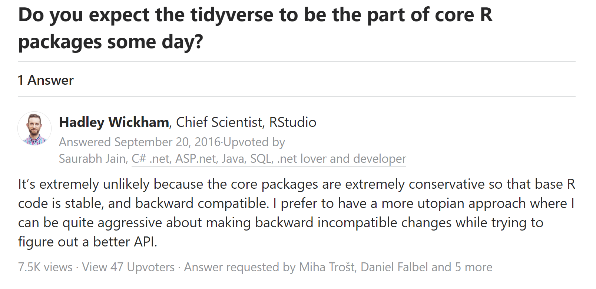
The trouble with the tidyverse
https://www.quora.com/Do-you-expect-the-tidyverse-to-be-the-part-of-core-R-packages-some-day

Slide 20
Why (not) tidyverse?
(in Hadley’s words)
Utopian, aggressive
NOT Conservative, NOT stable
NOT Backward-compatible
Some don’t want it: https://github.com/matloff/TidyverseSkeptic
While RStudio (the company) is a PBC, we need to keep an eye on the dominance of RStudio-contributed packages

Slide 21
So why use tidyverse then?
It is dominant among data scientists using R today
It gets the job done
Great for reproducible research
Readable code! Great for teamwork

Slide 22
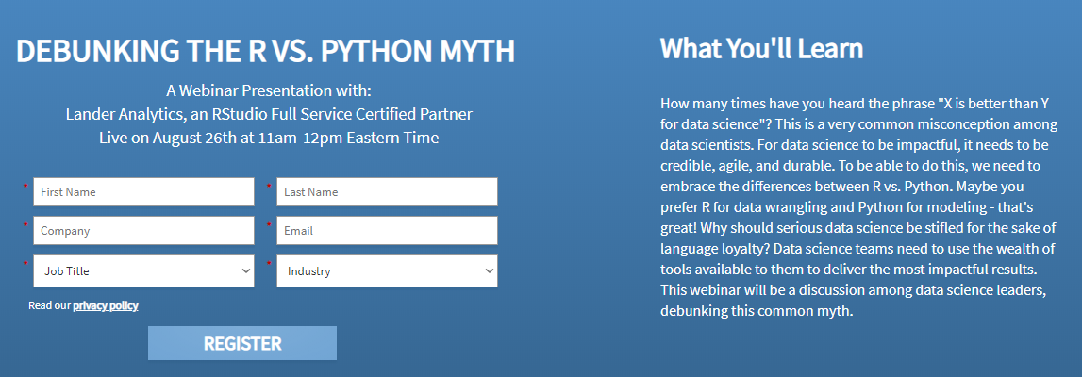
R vs Python – RStudio’s take
https://pages.rstudio.net/Debunking-the-R-vs-Python-Myth.html

Slide 23
The tidyverse approach includes ‘style’
The style guide provides great guidelines: https://style.tidyverse.org/index.html
It helps others, including your future self, to understand what you have done

Slide 24
Getting started with RStudio

Slide 25
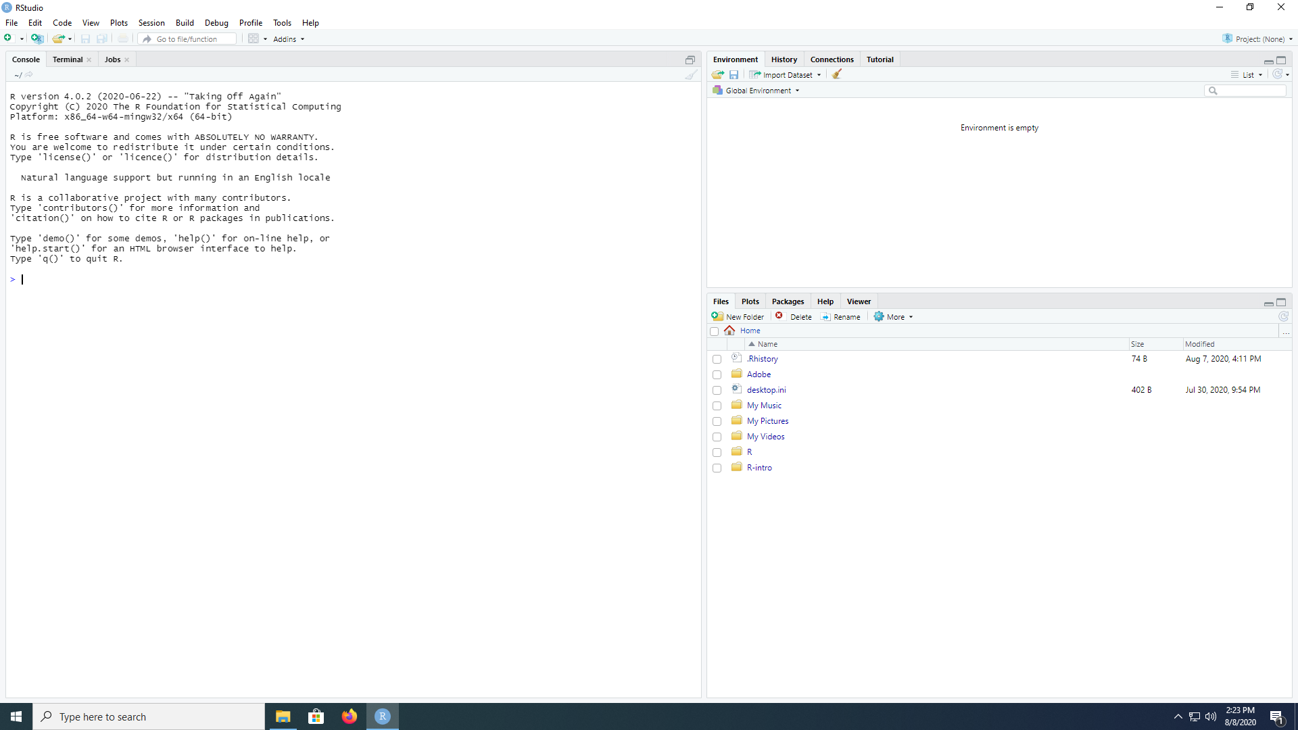
Create new files/projects
Load/Close/Create Projects
R console (this controls R)
System Terminal (to run things outside of R)
Jobs (We don’t need that right now)
Environment (objects in working memory)
History (previously entered commands)
Connections (database links)
Files (access scripts, data from your working directory/folder)
Plots (plots appear here)
Packages (load/install packages)
Help (Look up documentation)
Viewer (html output appear here)

Slide 26
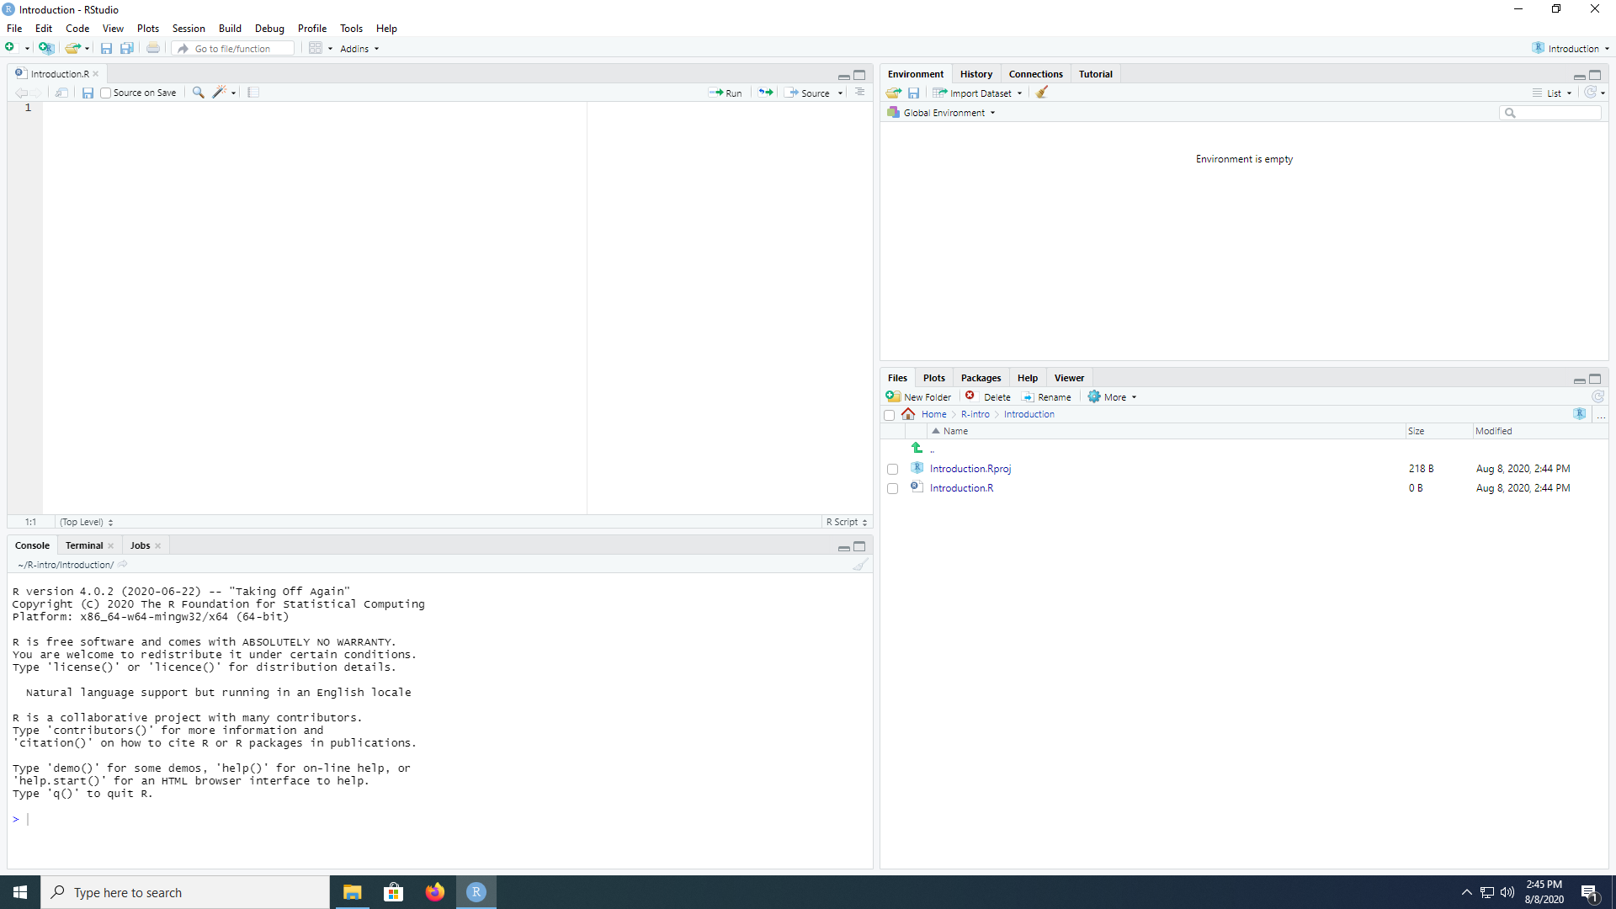
Project is loaded
This is your ‘editor’
R scripts …
… or .cpp code, sql code, …
Source (run entire script)
run (mark select code, run)
Organization of project files!
This is ‘where you run your code’
… either directly, like a terminal
… or where you see it run if you ‘source’ or ‘run’

Slide 27
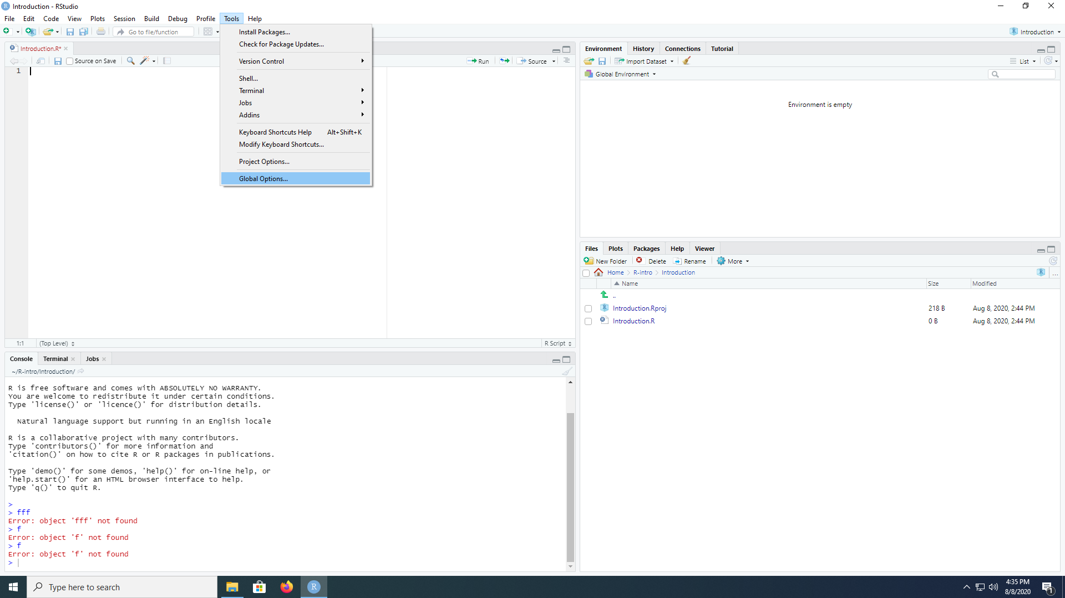
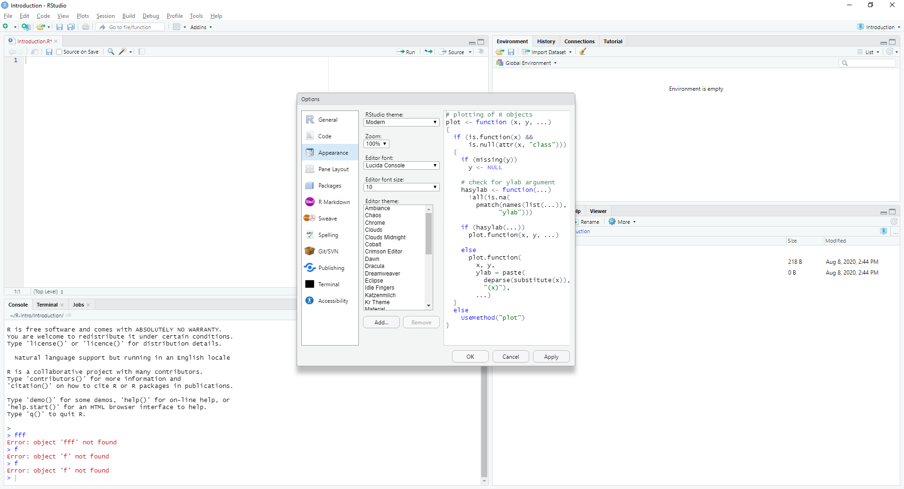
Options

Slide 28
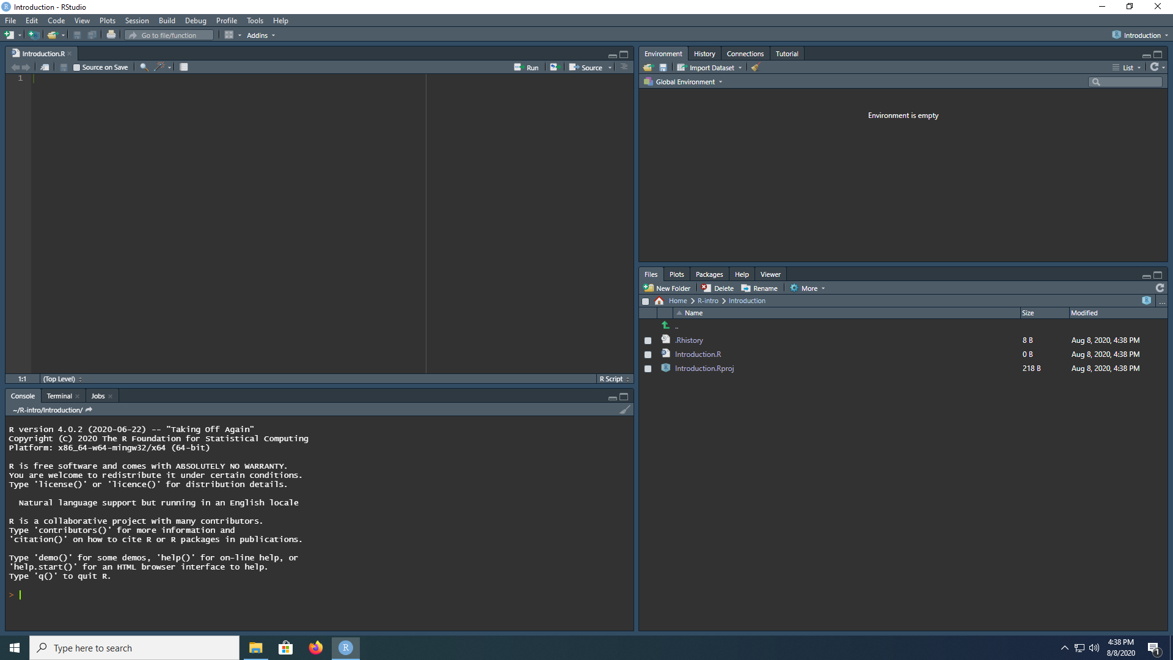
Dark mode enabled
(this theme is called
“Idle Fingers”)

Slide 29
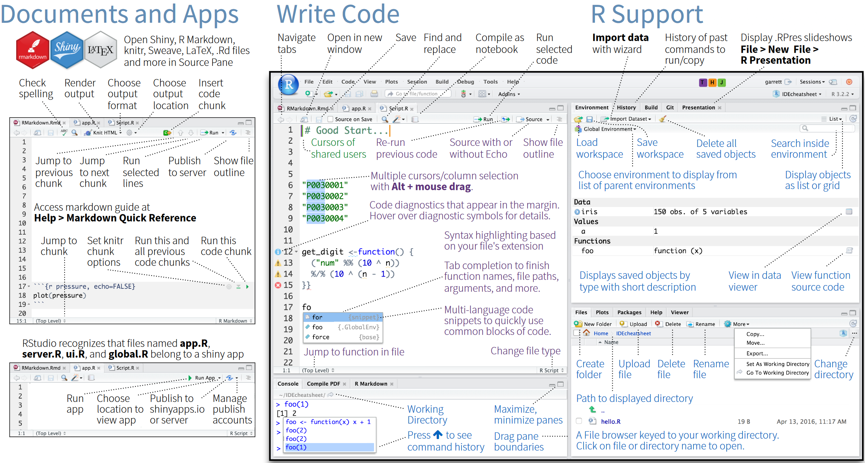
Cheat Sheet

Slide 30
Using ‘Base R’

Slide 31
Copy&Paste code and its pitfalls
vignette(“programming") #this will produce an error
vignette("programming") #this will work
vignette('programming') #this will work, too
vignette(`programming`) #this won't work either
Inverted commas can get ‘messed up’ when pasted to websites, into word documents, …
" ' are for entering strings (read: text)
` has specific purpose in some tidyverse functions (later)
“ is what word/powerpoint make of " automatically

Slide 32
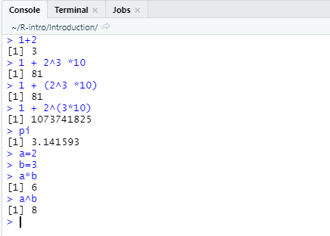
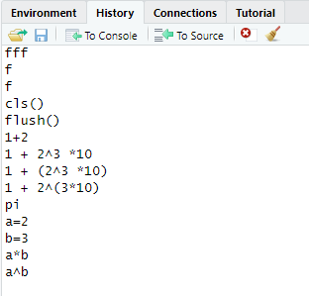
Console
R is a calculator
You can define variables and work with them
> symbol means the command you typed begins here
The [1] means the first value of the command’s results begins here
‘History’ tracks your inputs
However, not automatically saved

Slide 33
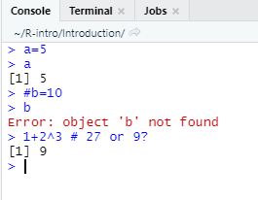
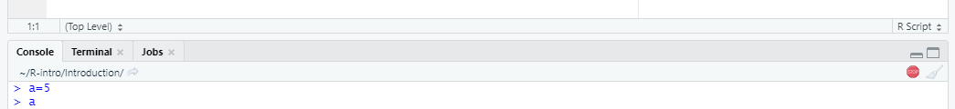
Other things to know
Use # to comment part of a line or the entire line
Use the STOP button on top of the console (or CTRL + C) to cancel a command (if it does not work, you are probably using an experimental package)

Slide 34
Follow along!
(1) Type the following command into the console. What does the : operator in R do?
1:17
(2) Type exactly what you see below in the console and then press Return.
str(iris
(3) Then type a right parenthesis and press Return. What’s happening?

Slide 35
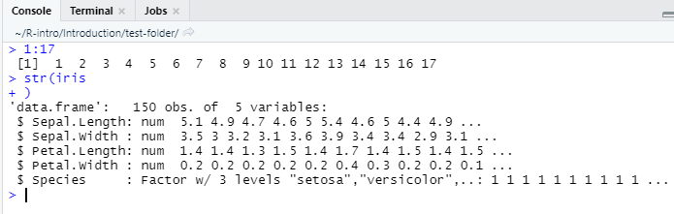
Answer
1:17 create a vector of integers (‘whole numbers’) from 1 to 17
str(iris is an incomplete command
R let’s you complete it on the next line
IDEs often help you; here RStudio already suggests the closing parenthesis

Slide 36
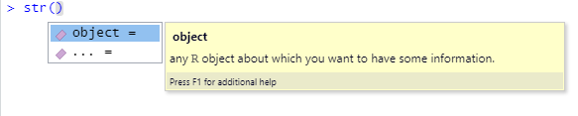

Code completion
RStudio helps with auto-completion
If you hit ‘tab’, you can see function arguments and help

Slide 37
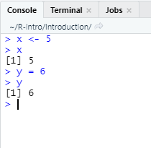
Storing Objects
Use the <- assignment operator to store objects as variables (ALT/Option + -)
You could also use =, however
<- is typically used for assigning values to variables
= is typically used for specifying parameter values in functions
(see Tidyverse Style Guide)
Enter the variable name to display its contents
Notes:
https://style.tidyverse.org/syntax.html#assignment

Slide 38
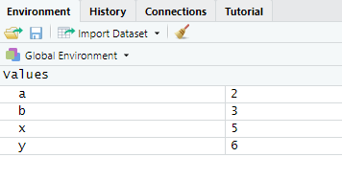
Storing Objects
Variables appear in the Environment pane after assignment
Variable names must:
Begin with a letter (or a period, if you want to hide it)
Only contain letters, digits, periods, and underscores
Reserved words in R cannot be used (e.g., TRUE)
Constants should not be overwritten (e.g., pi)
Think about a coherent naming scheme and use underscores `_` to replace spaces (e.g., sales_monthly_USD)

Slide 39
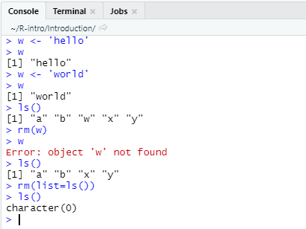
Storing Objects
When assigning strings, put it in ‘’ or “ ”
Like Linux, R is case sensitive
Use ls() to list all object names
Use rm() to remove objects
R lets you reassign objects with out warning (i.e. it overwrites variables)

Slide 40
Practice
Create a vector of integers from 1 to 50 Call it integer_vector_50
Use the function c() to create a separate two-element vector consisting of 0 and 1 by typing c(0,1) Call it logical_vector_2
Multiply the two vectors
Explain what happens

Slide 41
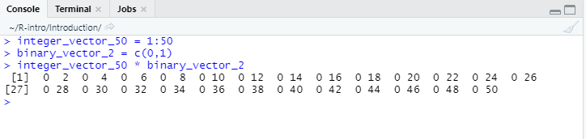
Answer
R computes element-wise product, recycling vectors to match dimensions (i.e. the binary_vector_2 is repeated 25 times in order)

Slide 42
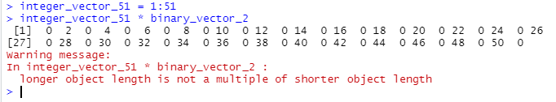
Recycling
Note: recycling a vector of length 2 to match a vector of length 50 is no problem
However, you will see a warning if dimensions don’t match (here: lengths 51 and 2)

Slide 43
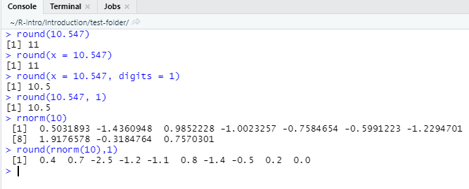
Functions
Type the function name and enter value(s)/data in the parentheses
Data passed into a function is called the function’s argument
Arguments can be results from another function
Use = to specify names of arguments, otherwise you need to follow the order of arguments specified by the function
Some arguments are optional, others are not

Slide 44
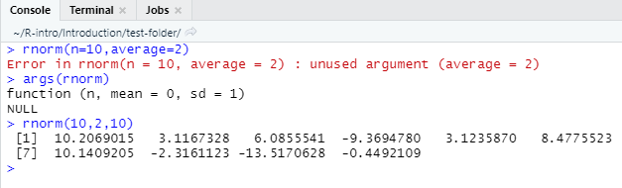
Functions’ arguments
When using named arguments, you need to specify names correctly
Use args() to look up a functions’ arguments
If not specified by name, R matches values to arguments in the function by order

Slide 45
Help
# details for specific function
help(sqrt) # OR
?sqrt
# examples for said function
example(sqrt)
# search help documentation if you forget the function’s name
??sqr

Slide 46
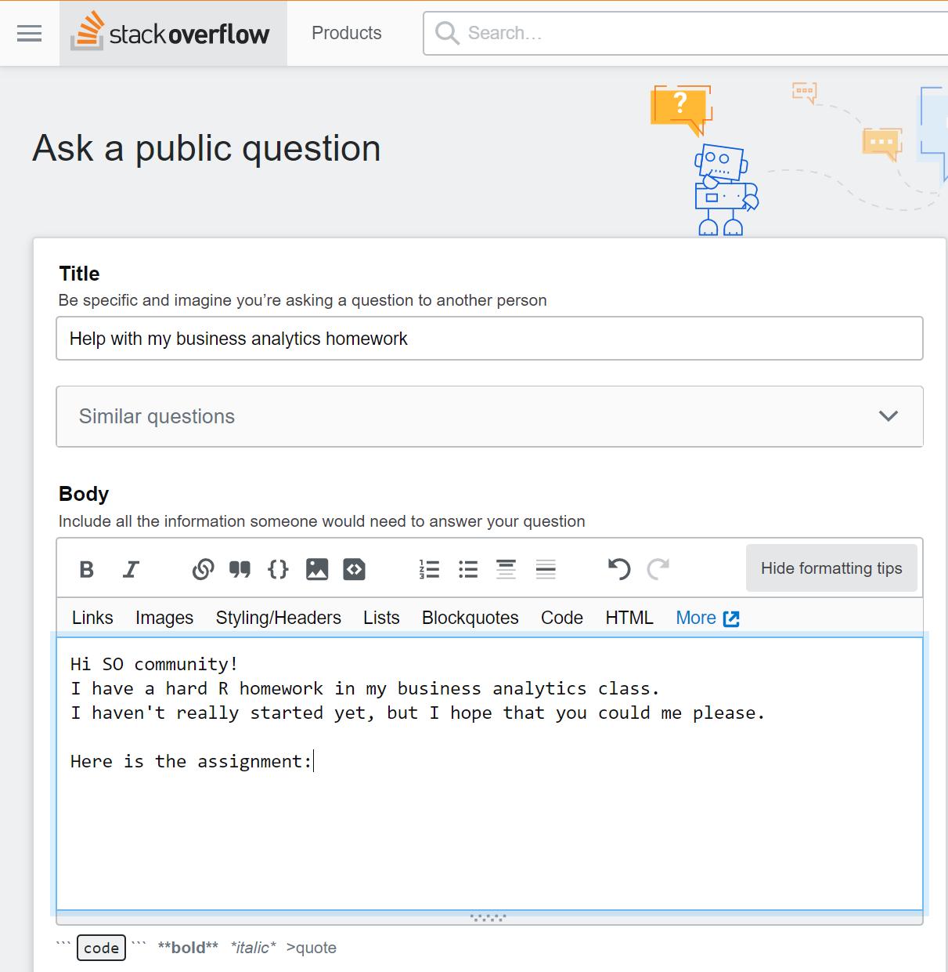
More help
Google
https://stackoverflow.com is a great resource!
However, it is NOT a platform to get help with your homework
Also, make sure to use the search function. The community really doesn’t like if you re-ask a question
For RStudio and tidyverse related questions, see https://community.rstudio.com/

Slide 47
Practice
Look at documentation for the quantile function.
What does the na.rm argument do? (how do you figure this out?)
Use the quantile function to find the 25th and 75th percentiles of the integers 1 through 150.

Slide 48
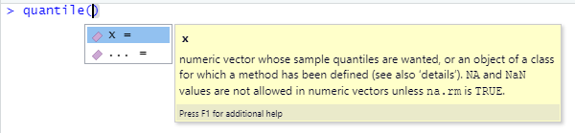
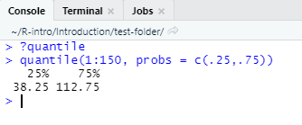
Answer
Either type quantile and TAB for the tooltip, or type ?quantile in order to find out what arguments do

Slide 49
Scripts
Place code in a script to save for later use/editing/additions
Open a new script by going to File → New File → R Script
Different ways to run code in a script
Clicking the Run button to execute the line of code the cursor is on (or the line(s) of code that you highlighted)
CTRL + Enter to run the line(s) of code that’s highlighted or that the cursor is on
Run the entire script by pressing the Source button

Slide 50
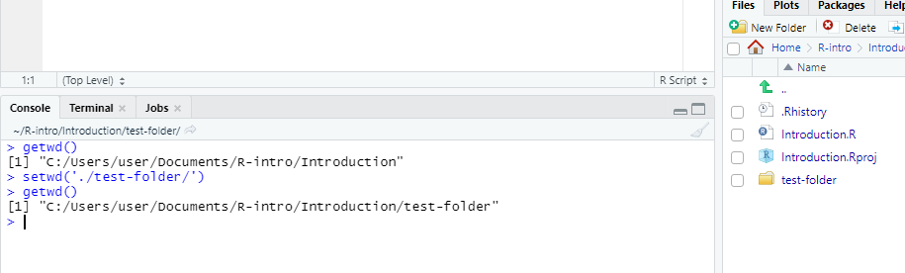
Working directory
Use getwd() to find out what you current working directory is, and setwd() to change it
If you work with an RStudio project, the working directory is equal to your project folder/directory
If you don’t have a project open, it is usually your home directory/folder

Slide 51
Packages
Everything we’ve discussed so far is considered “base R”, which means we do not require additional capabilities to use these functions
Packages are collections of custom functions and objects that extend the capabilities of base R
Examples of packages you may have seen already:
dplyr (useful for data manipulation)
ggplot2 (useful for visualization)

Slide 52
Package installation
# install packages from CRAN
install.packages("packagename")
install.packages(c(“pack1“,“pack2“))
# install packages from Bioconductor source("http://bioconductor.org/biocLite.R") # only 1st time
biocLite() # only 1st time
biocLite("packagename")
# install packages from GitHub
install.packages("devtools") # only 1st time
devtools::install_github("username/packagename")
#package manager
install.packages("pacman") # only 1st time p_load(packagename)
Installing from Github may require you to be able to compile (Rtools in Windows, CLI+GF8.2 in OSX)
I like pacman (a package manager, which itself is a package), but you can just use install.packages

Slide 53
Please install the following package
nycflights13
It contains a popular dataset used in R teaching
We might use it later on

Slide 54
Answer
install.packages("nycflights13")

Slide 55
What next?
Installing packages simply downloads them onto your hard drive. If you install from Github, code will be downloaded, compiled and then copied to your package folder.
Now you can load these packages
Keep in mind
You only need to install a package once (assuming the package hasn’t changed).
You need to load a package every time you start an RStudio session.

Slide 56
Loading packages
# load the package to use in the current R session
library(tidyverse)
require(tidyverse) # meant to be used within functions
# use a function from a package without loading the package or when the same function name appears in several packages
stringr::str_detect()
# provides details regarding contents of a package
help(package = "tidyr")
# list vignettes available for a specific package
vignette(package = "tidyr")
# view specific vignette
vignette("programming")

Slide 57
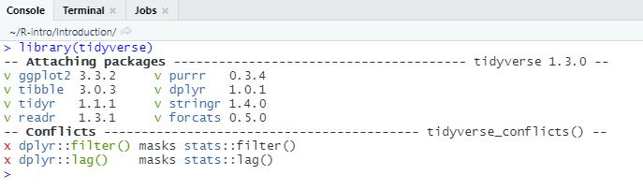
Warnings when loading packages
In this case: mostly harmless; however, there are ‘conflicts’: The function filter() is included in the package dplyr AND the package stats
It makes sense to be specific, i.e. use dplyr::filter or stats::filter
It’s PACKAGENAME::FUNCTIONNAME

Slide 58
Objects

Slide 59
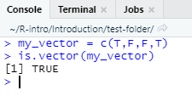
Atomic vectors
1d vectors of a single data type
Most simple data structure in R
Use is.vector() to test if an object is an atomic vector

Slide 60
Common atomic vectors
Four key types of atomic vectors: Logical, Integer, Double, Character
Some R functions refer to doubles as numerics
Use is.*() to test if an atomic vector is a certain data type, e.g. is.character()
Vector
Atomic
Numeric
Logical
Integer
Double
Character

Slide 61
Creating vectors
#character vector
character_vector <- c('foo', 'bar', 'hello', 'world’)
#numeric vector
numeric_vector <- seq(from=1,to=42,by=2)
#integer vector
integer_vector <- c(1L, 2L, 3L)
#logical vector
logical_vector <- c(T, F, F)
logical_vector <- c(TRUE, FALSE, TRUE) #better
Use the c() (concatenate) function to combine values into a vector (or a list)
Can use many operators or functions to create numeric vectors
Integers are stored as numerics by default. Use an uppercase L after each integer to ensure that it really is treated as integer (e.g. c(1L, 2L, 3L))

Slide 62
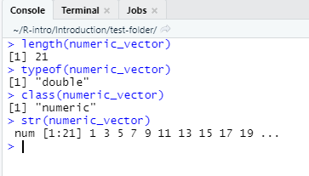
Examine vectors
Use length() to find the number of elements a vector has
Use typeof() or class() to identify the type of atomic vector
str() is a versatile function to examine the structure of an object; it shows class, length and example values

Slide 63
Practice Vectors
Look at documentation for the runif() function.
Create a vector with 75 observations that come from a uniform distribution with a minimum value of -3 and a maximum value of 14. (Don’t forget to assign this vector to a variable. You pick the name!)
Write functions to examine this vector:
Is it an atomic vector?
What kind of vector is it?
How long is the vector?

Slide 64
Solution
# look at documentation (2 ways), find out arguments
?runif
help(runif)
args(runif)
# create vector of length n=75
runif_vector <- runif( n = 75,
min = -3,
max = 14 )
# examine the vector
is.vector(runif_vector)
typeof(runif_vector)
length(runif_vector)

Slide 65
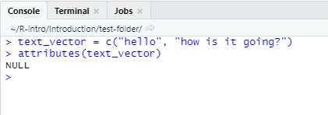
Attributes
Attributes are information you can attach to an R object (like meta information)
Attributes will not appear when displaying an object or affect object values
Check for all attributes with attributes()

Slide 66
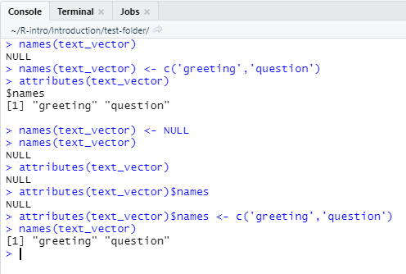
Attribute (names)
View the names of each element with names()
Assign new or change existing names by passing on a vector (typically of type character)
Remove value names by assigning NULL to names

Slide 67
Coercion
Combining different data types or forcing functions on certain data types results in coercion
Vector coercion in R always follows a predetermined procedure
numeric
TRUE → 1
FALSE → 0
1 → “1”
2 → “0”
logical
character

Slide 68
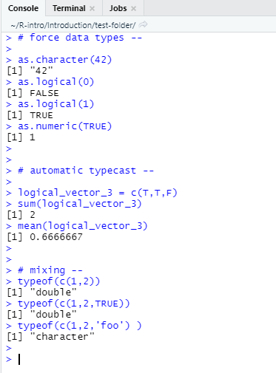
Coercion - Examples
You can force conversion between data types
R also automatically converts as needed

Slide 69
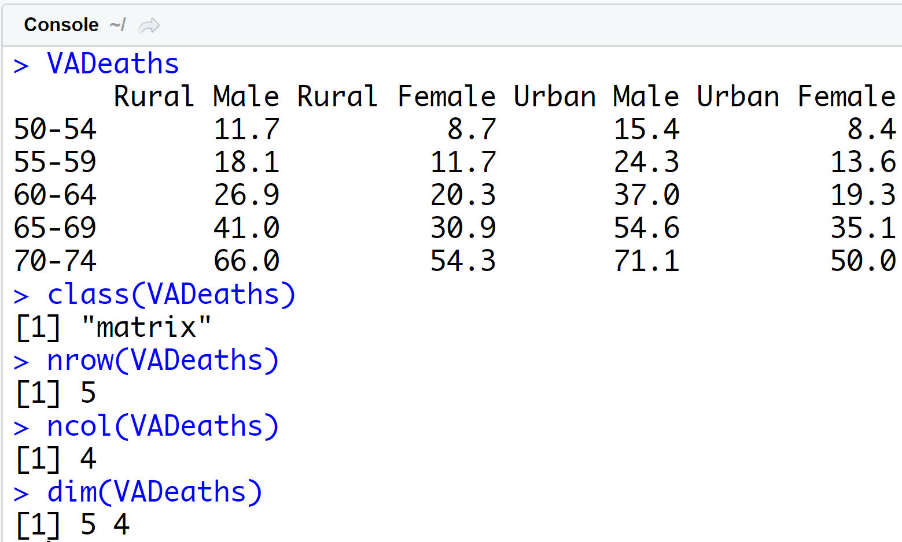
Matrix
Two-dimensional array
Numeric data only
Use the matrix() function to create a matrix

Slide 70
Practice - Matrices
Look at documentation for the matrix() function.
Create a 5x4 matrix of the integers from 1 to 20, filling by rows. Save the matrix as a variable called example_matrix.
Examine the names, class, and dimensions of this matrix.

Slide 71
Solution
# documentation for matrix()
?matrix
# create the matrix
example_matrix <- matrix( data = 1:20,
nrow = 5,
ncol = 4,
byrow = TRUE )
# examine attributes
names(example_matrix) # NULL
class(example_matrix) # matrix/array
typeof(example_matrix) # integer
dim(example_matrix)

Slide 72
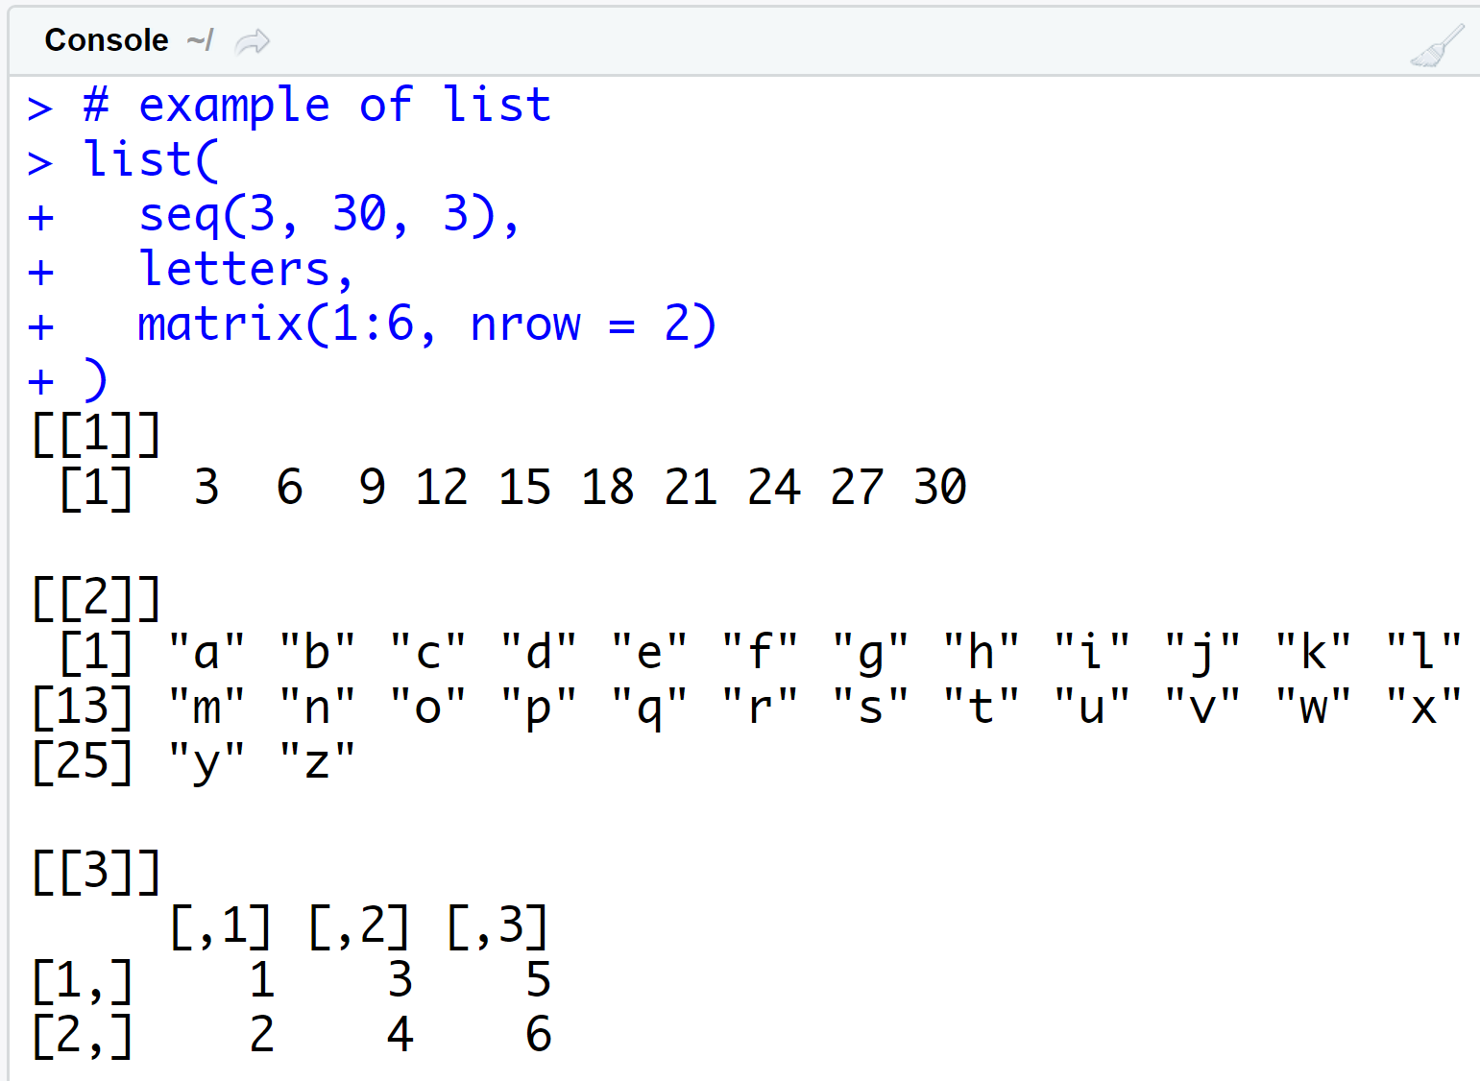
List
One dimension
Each element can be its own object (a vector, matrix, data frame, or even a list)
Use the list() function to create a list
You’ll see lists frequently with linear models

Slide 73
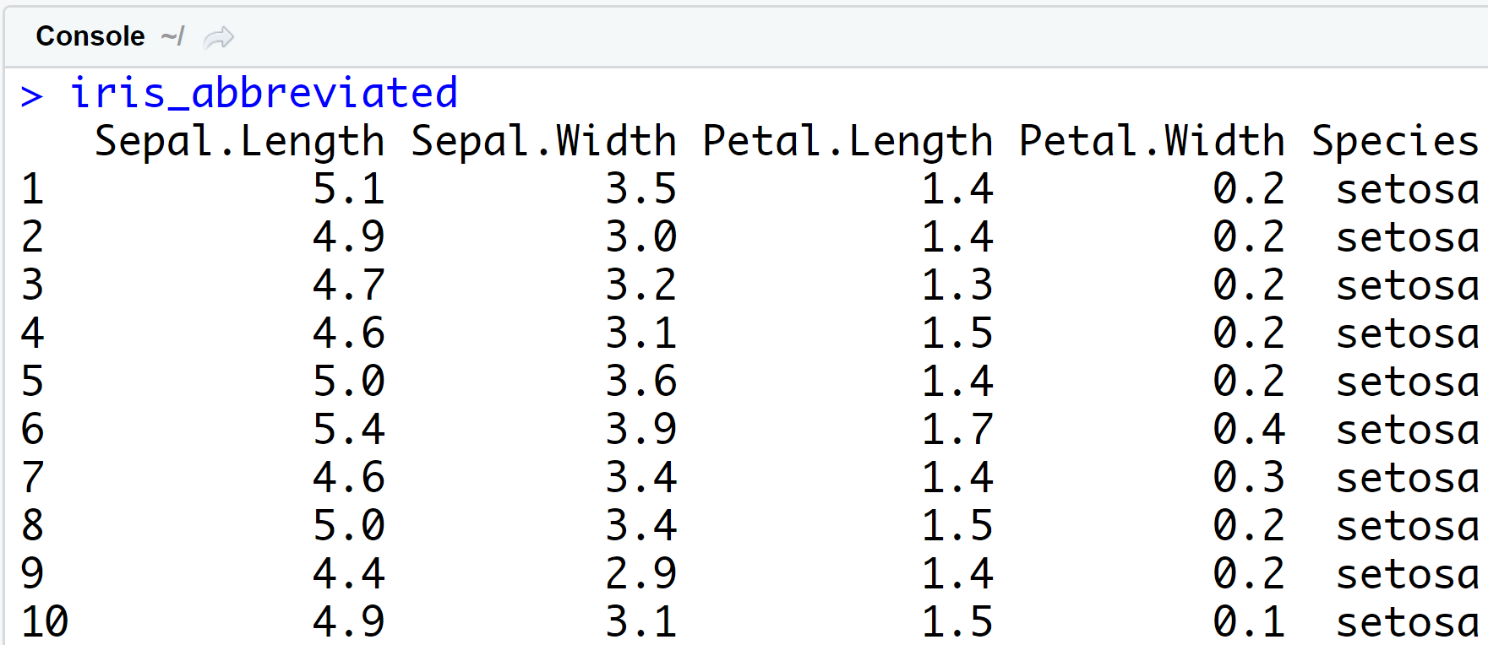
Data Frame
Two-dimension version of a list (think of a spreadsheet)
Named list of vectors with specific attributes
Each vector become a column
Vectors (i.e., columns) must be the same length in a data frame

Slide 74
Data Frame
Use the data.frame() function to create a data frame
Data frames have a special data.frame class
Use str() to examine the structure of a data frame

Slide 75
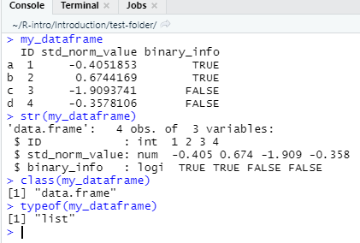
Data Frame - example
my_dataframe <- data.frame(
#3 columns of data
ID = 1:4,
std_norm_value = rnorm(4),
binary_info = c(T,T,F,F),
#additional information
row.names = c("a", "b", "c", "d"),
stringsAsFactors = FALSE)

Slide 76
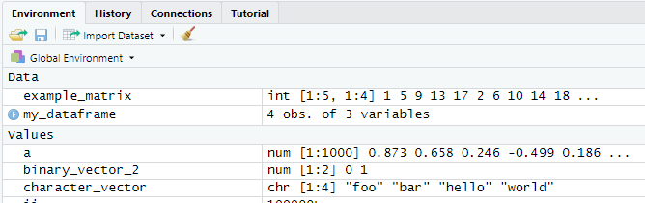
The Environment shows objects loaded in memory
Data (matrices, data frames,…)
Values (atomic vectors)
Functions

Slide 77
Overview of common objects
Data Frames: composed of observations (the rows) across multiple variables (the columns). Most commonly used structure in R
Data Types:
Numeric: A double-precision data element
Integer: Data element limited to integer values
Character: Data composed of string values
Factors: Integer data wherein numeric values are represented as strings
Logical: Data element limited to True or False values
Vectors/Matrices/Arrays: One, two, or larger - dimensional arrays of data
Lists: Objects that contain multiple other objects (scalars, matrices, etc.)
Functions: Objects designed to perform specific tasks with specific inputs

Slide 78
Importing Data
Use the read.csv() function to read in .csv files
Other read.* functions exist for various file formats
Watch the stringsAsFactors argument – by default strings are converted to factors in R<4.x
The ‘readr’ package contains a new ‘read_csv’ function. It is integrated in the ‘import dataset’ feature in RStudio. However, read.csv works fine.
If you have large amounts of data, .csv is probably not the format to go with

Slide 79
Exporting Data
Use the write.csv() function to save .csv files to your hard drive
Watch the row.names argument!

Slide 80
Style

Slide 81
Style guide and collaboration
Reminder!
The tidyvserse style guide provides great guidelines: https://style.tidyverse.org/index.html
It helps others, including your future self, to understand what you have done

Slide 82
Naming scripts
script1.r
detail.r
Huh?
weather_analysis.R
ATM_CSAT_review_text-analysis.R
Better

Slide 83
Naming objects
naming_convention
naming.convention
_ works well!
namingconvention
namingConvention
NamingConvention
Not as clear

Slide 84
Code Organisation
#################
# LOAD Data #
#################
lines of code here
###################
# Preprocess Data #
###################
lines of code here
Structure helps
line of code here
line of code here
line of code here
line of code here
line of code here
line of code here
line of code here
Even you will get lost sooner or later

Slide 85
Code spacing
average<-mean(feet/12+inches,na.rm=TRUE)
Hard to read
average <- mean(feet / 12 + inches, na.rm = TRUE)
Easier to read

Slide 86
Selecting values

Slide 87
Selecting values
Use [ ] brackets to select values from a vector
Can use the following to subset:
Positive integers
Negative integers
Zero
Blank spaces
Logical values
Names

Slide 88
Practice - Selecting
Use the following commands to create a vector of 26 random values.
The set.seed() ensures we all get the same ‘random’ numbers
rnorm() generates random numbers following a Normal distribution
set.seed(1234)
my_vector <- rnorm(n = 26, mean = 0, sd = 5)
names(my_vector) <- letters

Slide 89
Practice - Selecting
Run each of the following commands.
my_vector[]
my_vector[5]
my_vector[3:7]
my_vector[c(1,3,6)]
my_vector[-(2:14)]
my_vector[0]
my_vector[c(TRUE, FALSE, TRUE, FALSE, FALSE)]
my_vector[c("b", "n", "r")]

Slide 90
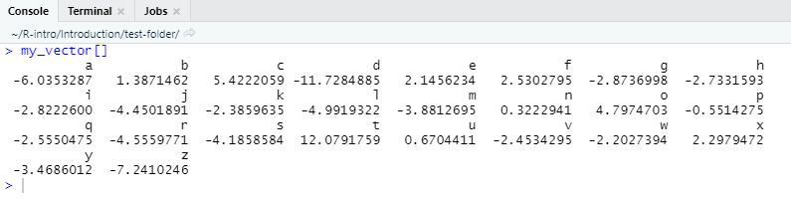
my_vector[]
select every element of my_vector

Slide 91
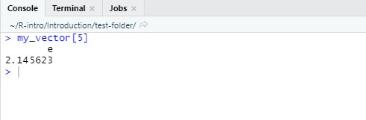
my_vector[5]
select the fifth element of my_vector

Slide 92
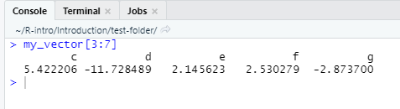
my_vector[3:7]
select the 3rd through 7th elements of my_vector

Slide 93
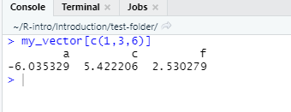
my_vector[c(1,3,6)]
select the 1st, 3rd, and 6th elements of my_vector

Slide 94
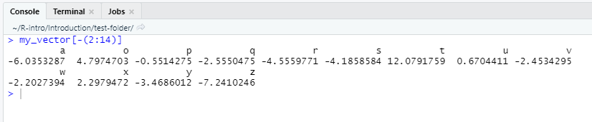
my_vector[-(2:14)]
select every element of my_vector EXCEPT the 2nd through 14th elements

Slide 95
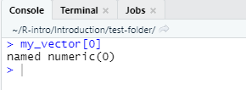
my_vector[0]
returns an empty object

Slide 96
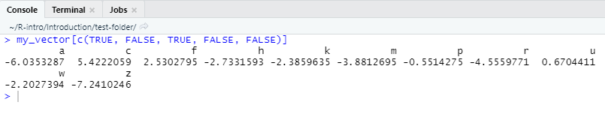
my_vector[c(TRUE, FALSE, TRUE, FALSE, FALSE)]
returns the 1st element, excludes the 2nd element, returns the 3rd element
excludes the 4th and 5th elements
repeat this pattern through the entire vector (e.g. recycling the binary T/F vector to match my_vector)

Slide 97
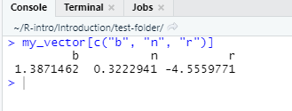
my_vector[c("b", "n", "r")]
select the elements named b, n, and r of my_vector
can only do this when elements have names

Slide 98
Selecting rows
In the next exercise, we practice selection rows or cases off a dataset

Slide 99
Practice – Selecting
Look at documentation for the WorldPhones data set in R (R has many built-in data sets to make learning easy and fun). Examine the dataset (start by using str())
Hints
WorldPhones[,] will return all rows and columns of the data frame
You have seen how vectors are indexed or subsetted, this also applies to matrices, where we index WorldPhones[row,col]
Please extract the following (see next slide)

Slide 100
Practice - Selecting
The first row and all columns from WorldPhones
The 2nd, 3rd, and 6th rows; the 2nd through 5th columns
All rows; repeat the 3rd column twice
All rows; every column except the 1st and 7th
An empty data frame (think an empty object)
The second-to-last row by using a function and not the number 6; all columns

Slide 101
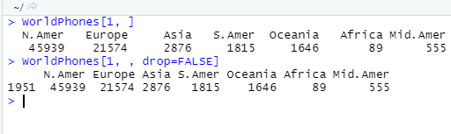
The first row and all columns from WorldPhones
WorldPhones[1, ]

Slide 102
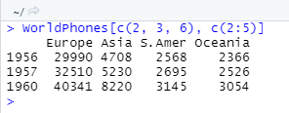
The 2nd, 3rd, and 6th rows; the 2nd through 5th columns
WorldPhones[c(2, 3, 6), c(2:5)]

Slide 103
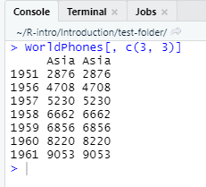
All rows; repeat the 3rd column twice
WorldPhones[, c(3, 3)]

Slide 104
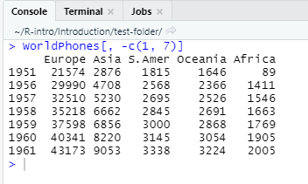
All rows; every column except the 1st and 7th
WorldPhones[, -c(1, 7)]

Slide 105
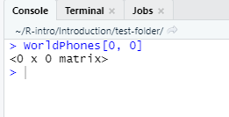
An empty data frame (think an empty object)
WorldPhones[0, 0]

Slide 106

The second-to-last row by using a function and not the number 6; all columns
WorldPhones[nrow(WorldPhones) - 1, ]

Slide 107
Selecting columns
While rows represent cases/observations/individuals/households, columns represent variables
Typically, data is stored in data frames
Base R
[,col] notation
[id] to access matrix elements by number
$ for named columns
[[index]] to access list elements (note: data frames are lists)
Tidyverse/dplyr has more intuitive ways to do this, but understanding base R is important – it’s stable, while dplyr functions can change any time

Slide 108
Selecting columns
Preserve the structure of the output to be the same as the input with data_frame[column]
Can use a column name in quotes or a column index
Simplify the structure of the output with data_frame[[column]]
Can use a column name in quotes or a column index
Simplify the structure of the output to be a smaller structure than the input with data_frame$column
Must use a column name with a $

Slide 109

Selecting columns
We use the mtcars sample dataset – it is a data.frame

Slide 110


Selecting columns (preserve structure via `[`)

Slide 111

Selecting columns via `[`
Both ways yield a data.frame (with 1 column)

Slide 112


Selecting columns (simplify structure via `[[`)

Slide 113

Selecting columns (simplify structure via `[[`)
Both ways yield a data.frame (with 1 column)

Slide 114


Selecting columns (simplify structure via `$`)

Slide 115

Selecting columns (simplify structure via `$`)
Indexing via $ also yields simplified structure (vector)

Slide 116
Selecting values from Lists
Use $, [ ], and [[ ]] to select items and values from lists
Sometimes need combinations of $, [ ], and [[ ]] to extract desired information
Also, data.frame are Lists

Slide 117
Practice - lm
Run the command
model <- lm(mpg ~ ., data = mtcars)
Run the command str(model) to examine your model object called `model`
What do the following commands do? What structures should you expect?
model["fitted.values"]
model$coefficients[["wt"]]
model[["residuals"]][1:10]

Slide 118

Answer - lm
# Linear model, mpg as a function of every other variable in the mtcars data set
model <- lm(mpg ~ ., data = mtcars)
# look at structure of model
str(model)

Slide 119


Answer - lm
# Look at the fitted values of the linear model
# Output structure is a list
model["fitted.values"]
# look at class of output
class(model["fitted.values"])

Slide 120

Answer - lm
# Look at the weight coefficient
model$coefficients[["wt"]]
# look at class of output
# Output structure is a numeric vector
class(model$coefficients[["wt"]])

Slide 121

Answer - lm
# Look at the residuals
model[["residuals"]][1:10]
# look at type of the residuals
typeof(model[["residuals"]][1:10])

Slide 122
Modifying values

Slide 123
Changing values of a vector one at a time
# Create some example vector
some_vector <- c(1, 2, 3, 4, 5)
# Overwrite the first value with 2342243
some_vector[1] <- 2342243
# Check
some_vector
[1] 2342243 2 3 4 5
Describe the value(s) you want to modify
Then use the <- assignment operator to overwrite the value(s) you described!
Modifying elements overwrites previous values

Slide 124


Modifying several values
# Create some example vector
some_vector <- c(1, 2, 3, 4, 5)
# Overwrite the 1st and 3rd values with 99 and 999
some_vector[c(1, 3)] <- c(99, 999)
# Overwrite the other values with -2
some_vector[c(2, 4, 5)] <- -2
# Check
some_vector
Can change multiple values at once

Slide 125

Modifying values in data.frames
# save a copy of the iris data frame
iris_df <- iris
# select the Sepal.Length column then change the first 3 values in that column
# to the same value iris_df$Sepal.Length[1:3] <- 1000
# to individual values iris_df$Sepal.Width[1:3] <- c(9,99,999)
# Check
head(iris_df)[1:3,]
To modify data frame values:
Select a column
Subset for the elements you want to modify
Assign a vector of values to replace them!

Slide 126
Modifying values with logical (TRUE/FALSE) operators
1 != 2
[1] TRUE
3 > c(5, 1, 3)
[1] FALSE TRUE FALSE
c(5, 1, 3) == c(3, 1, 5)
[1] FALSE TRUE FALSE
1 %in% c(5, 1, 3)
[1] TRUE
c(19, 3) %in% c(5, 1, 3)
[1] FALSE TRUE
c(1, 8, 0, 9) %in% c(5, 1, 3)
[1] TRUE FALSE FALSE FALSE
Operator | Syntax
> | a > b
>= | a >= b
< | a< b
<= | a <= b
== (check for equality) | a == b
!= (check for not equal) | a != b
%in% (check for group membership) | a %in% c(a, b, c)

Slide 127
Using logic
# save a copy of the iris data frame
iris_df <- iris
# TRUE/FALSE Boolean values for
# if Petal.Width is greater than 1 iris_df$Petal.Width > 1
# only observations with Petal.Width > 1
# show Petal.Width column iris_df$Petal.Width[iris_df$Petal.Width > 1]
# change all Petal.Width > 1 values to -3 iris_df$Petal.Width[iris_df$Petal.Width > 1] <- -3
We can leverage logical comparisons to modify values in vectors
Think through what each command outputs and how logical comparisons select which elements to modify!
No, you don’t need all three steps every time you want to logically subset!

Slide 128
Subset and select
# filter for observations with a Sepal.Length
# greater than 7.3
# and show all columns for those observations iris[iris$Sepal.Length > 7.3, ]
# filter for observations with:
# 1) Sepal.Length greater than 7.3, AND
# 2) Petal.Length greater than 6.3
iris[iris$Sepal.Length > 7.3 & iris$Petal.Length > 6.3, ]
# filter for observations with:
# 1) Sepal.Length greater than 7.3, OR
# 2) Petal.Width < 1.8
iris[iris$Sepal.Length > 7.3 | iris$Petal.Width < 1.8, ]
Use logical comparisons to filter for certain observations and then select all columns from a data frame
Combine logical comparisons with & or | (and or…..or)

Slide 129
Not %in%
'%!in%' <- function(x,y)!('%in%'(x,y))
`%!in%` <- Negate(`%in%`)
There is no built-in function for “not in”
However, it’s easy to define a new function called %!in% that does just that
Using negate is even more elegant

Slide 130
Practice – Modifying values
Read documentation for the esoph built-in R data set.
Filter the esoph data set for observations (showing all columns) with:
Tobacco consumptions either 0-9 grams per day or 10-19 grams per day, AND Number of cases greater than zero

Slide 131

Answer – Modifying values
# Documentation
?esoph
# pull information
esoph[esoph$tobgp %in% c("0-9g/day", "10-19") & esoph$ncases > 0, ]

Slide 132
Missing Data “NA”s

Slide 133

Missing values in R
R shows missing values as NA
Missing values prevent R from calculating sums, means, equality checks, etc.
Use the is.na() function to check for missing values - this function is another logical operator in R

Slide 134

Counting missing values
Use the is.na() function to check for missing values—this function is another logical operator in R
Use sum(is.na()) to calculate the total number of missing values
Use colSums(is.na()) to calculate the number of missing values per column
Notes:
# example data frame
df <- data.frame(col1 = c(1:3, NA),
col2 = c("this", NA,"is", "text"),
col3 = c(TRUE, FALSE, TRUE, TRUE),
col4 = c(2.5, NA, NA, NA),
stringsAsFactors = FALSE)
# illustrate is.na() function
is.na(df)
# count missing values
sum(is.na(df))
colSums(is.na(df))

Slide 135

Remove incomplete observations
Use complete.cases() to keep only observations with no missing values
Can also use na.omit() to remove incomplete observations
Discuss with stakeholders before simply removing observations! Maybe missing data exists for a reason!
Notes:
# complete cases
complete.cases(df)
# subset with complete observations only
df[complete.cases(df), ]
# or subset with `!` operator to retrieve incomplete cases
df[!complete.cases(df), ]
# can also use na.omit() to subset for complete obs. Only
na.omit(df)

Slide 136

In-function missing value handling
Some standard functions like mean() or median() have the na.rm argument controlling how NAs are handled
It is equivalent to using na.omit() within calling the mean() function
However, the na.rm argument is not used consistently across all R packages

Slide 137

table()
The table() function creates frequency tables
By default, NAs are excluded
If you want to include the frequency of NAs, you have to use the useNA = ‘always’ argument

Slide 138
Practice – Missing Data
How many missing values are in the built-in data set airquality?
Which variables are the missing values concentrated in?
How would you impute the mean or median for these values?
How would you omit all rows containing missing values?

Slide 139

Answer – Missing Data
# 1) how many missing values?
# number of missing values sum(is.na(airquality))
# 2) which variables have missing values
# number of missing values by variable colSums(is.na(airquality))

Slide 140

Answer – Missing Data
# let’s save a copy of the data set, first airquality_copy <- airquality
# 3) how to impute the mean/median
# imputing, for example, the mean for the Ozone variable airquality_copy$Ozone[is.na(airquality_copy$Ozone)] <- mean(
airquality_copy$Ozone,
na.rm = TRUE)
# number of missing values by variable colSums(is.na(airquality_copy))

Slide 141

Answer – Missing Data
# 4) keep complete cases only
# use any of the following functions
airquality_complete <- airquality[complete.cases(airquality),]
airquality_complete <- na.omit(airquality)
sum(is.na(airquality_complete))

Slide 142
Data exploration

Slide 143
Explore your data
Before getting deep into modeling, we conduct exploratory data analysis (EDA)
For quick data exploration, base R plotting functions can provide an expeditious and straightforward approach to understanding your data
We usually begin with univariate analysis, i.e. looking into one variable at a time
Then, we may turn to bivariate analysis
Cross-tables (relationships between two categorical variables)
Correlations (relationships between two numeric variables)
Sub-group analysis (relationship between numeric and categorical variables)
We may also use simple regression models (using the lm() function) to find patterns in our data

Slide 144
Reminder
This week is about getting to know ‘base R’
There are lots of fancy packages for EDA, and will use them later

Slide 145

table()
table() can create frequency tables AND contingency tables
Here: Relationship between transmission (in columns) and engine layout (in rows) in the mtcars dataset
Using prop.table(.,1) computes rowwise percentages, prop.table(.,2) columnwise percentages

Slide 146

cor()
cor() lets you compute Pearson, Kendall and Spearman correlation – default is Pearson correlation

Slide 147

Subgroups and descriptives
Aggregate(), by() and tapply() are functions that help compute group-wise statistics
E.g., compute the average displacement by the number of cylinders in the mtcars dataset
I prefer aggregate for its output
aggregate(mtcars$disp~mtcars$cyl,FUN='mean')
Notes:
mean(mtcars$disp[mtcars$cyl==4])
mean(mtcars$disp[mtcars$cyl==6])
mean(mtcars$disp[mtcars$cyl==8])
aggregate(mtcars$disp~mtcars$cyl,FUN='mean')
by(mtcars$disp,mtcars$cyl,mean)
tapply(mtcars$disp,mtcars$cyl,mean)

Slide 148
Base R plots
The plot() function uses information in objects to find the right plot
Some base R plotting functions let you specify the data set without using $ to select variables for each argument
Base R plots may not be pretty but they’re quick to make
# super quick scatterplot with the mtcars data
# displacement vs quarter mile time
plot(mtcars$disp, mtcars$qsec)

Slide 149
Practice
Use the chickwts data set to make the following summaries:
A table of the feed variable. Use the $ symbol to select the feed variable here.
A histogram of the weight variable.
Boxplots of the weight variable by feed. Look at documentation for the data set and for the boxplot() function if needed.
Compute average weight by feed.

Slide 150

Solution
# 1) table of the feed variable
table(chickwts$feed)

Slide 151
Solution
# 2) histogram of the weight variable hist(chickwts$weight)

Slide 152
Solution
# 3) boxplots
# use either command below
# both produce the same boxplots
boxplot(weight ~ feed, data = chickwts)
boxplot(chickwts$weight ~ chickwts$feed)

Slide 153

Solution
# 4) Compute average weight by feed
aggregate(chickwts$weight~chickwts$feed, FUN='mean')

Slide 154
Week 1 - Key functions
Operator/Function | Description
help(), ?, example() | Get help on functions and provide examples
getwd(), setwd() | Get and set your working directory
+, -, *, /, ^ | Arithmetic
<- | Assignment operator
ls(), rm() | list and remove objects in your global environment
install.packages(), library() | Install and load packages
vignette() | View/list package vignette

Slide 155
Numerical summaries
Base R Function | Description
dim(), nrow(), ncol() | Number of rows and columns
names() | Variable names
head(), tail() | First few rows or last few rows
str() | Structure of data
is.na(), sum(is.na()), colSums(is.na()) | Missing values
summary(), sd(), quantile(), range() | Summary statistics
table(), prop.table() | Frequency/Crosstable of values
aggregate(x~y,FUN='mean’) | Mean of x grouped by y

Slide 156
Basic plots
Function | Description
plot(x, y) | scatter plot
plot(x, y, type = “l”) | line chart
barplot(table(x)) | bar chart
hist(x) | histogram
boxplot(y ~ x, data) | box plot

